Slide 1


Web scraping project
Is BTS really popular in United State than in South Korea?
Did the recognition of Korea and the United States affect each other?
Reporter: KISOO CHO
Notes:
My topic to present today is whether BTS is really more popular in America than in Korea.
And I'm going to analyze how recognition in Korea and the United States has affected each other.

Slide 2
Who are BTS?
Also known as
Bangtan Boys
Bangtan Sonyeondan
Beyond the Scene
Bulletproof Boy Scouts
Labels
Big Hit・Pony Canyon ・
Def Jam Japan ・Columbia
Member
Origin
Jin
Suga
J-Hope
RM
Zimin
V
Jungkook
Seoul, South Korea
2013.6 ~ present
Notes:
These are BTS.
Some of you have heard of BTS, and some of you have heard of them at the very beginning. I didn't have much interest in BTS before this project either. I was much interested in girl groups like twice.
The reason I chose this topic is because oneday, suddenly, many media reported that BTS topped the Billboard charts, then BTS began to be mentioned more actively than ever before.
It was because I thought BTS became more popular in Korea after that.

Slide 3

How did I it?
Melon
Web Scraping with scrapy
Web Scraping with selenium
Billboard
200
Billboard
Artist100
Billboard
Hot100
Web Scraping with scrapy
Web Scraping with scrapy
Are leading/following charts identified?
Is there a connection between each data?
Notes:
From BTS debut to present, I selected the Billboard 200/hot 100/artist 100 from Billboard.com and compare it with the top 100 ranking from Melon.com.
You all know what is Billboard, and Melon is a Korean music streaming service. Although recently it has been controversial for its abusing to raise ranking, it still present popular music ranking.
I'm going to check two things with this data.

Slide 4
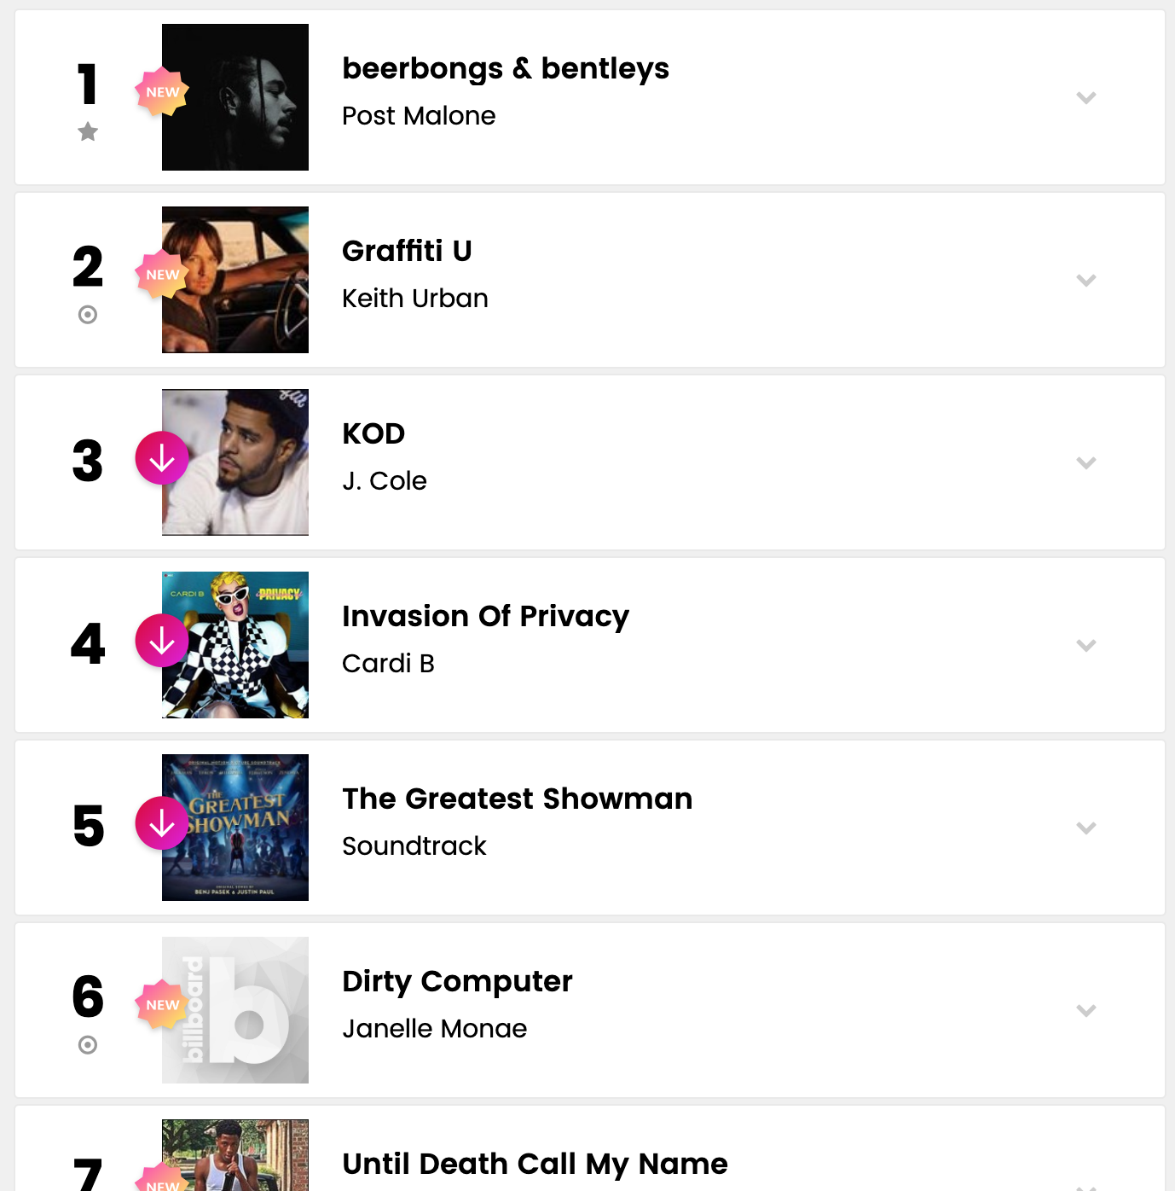
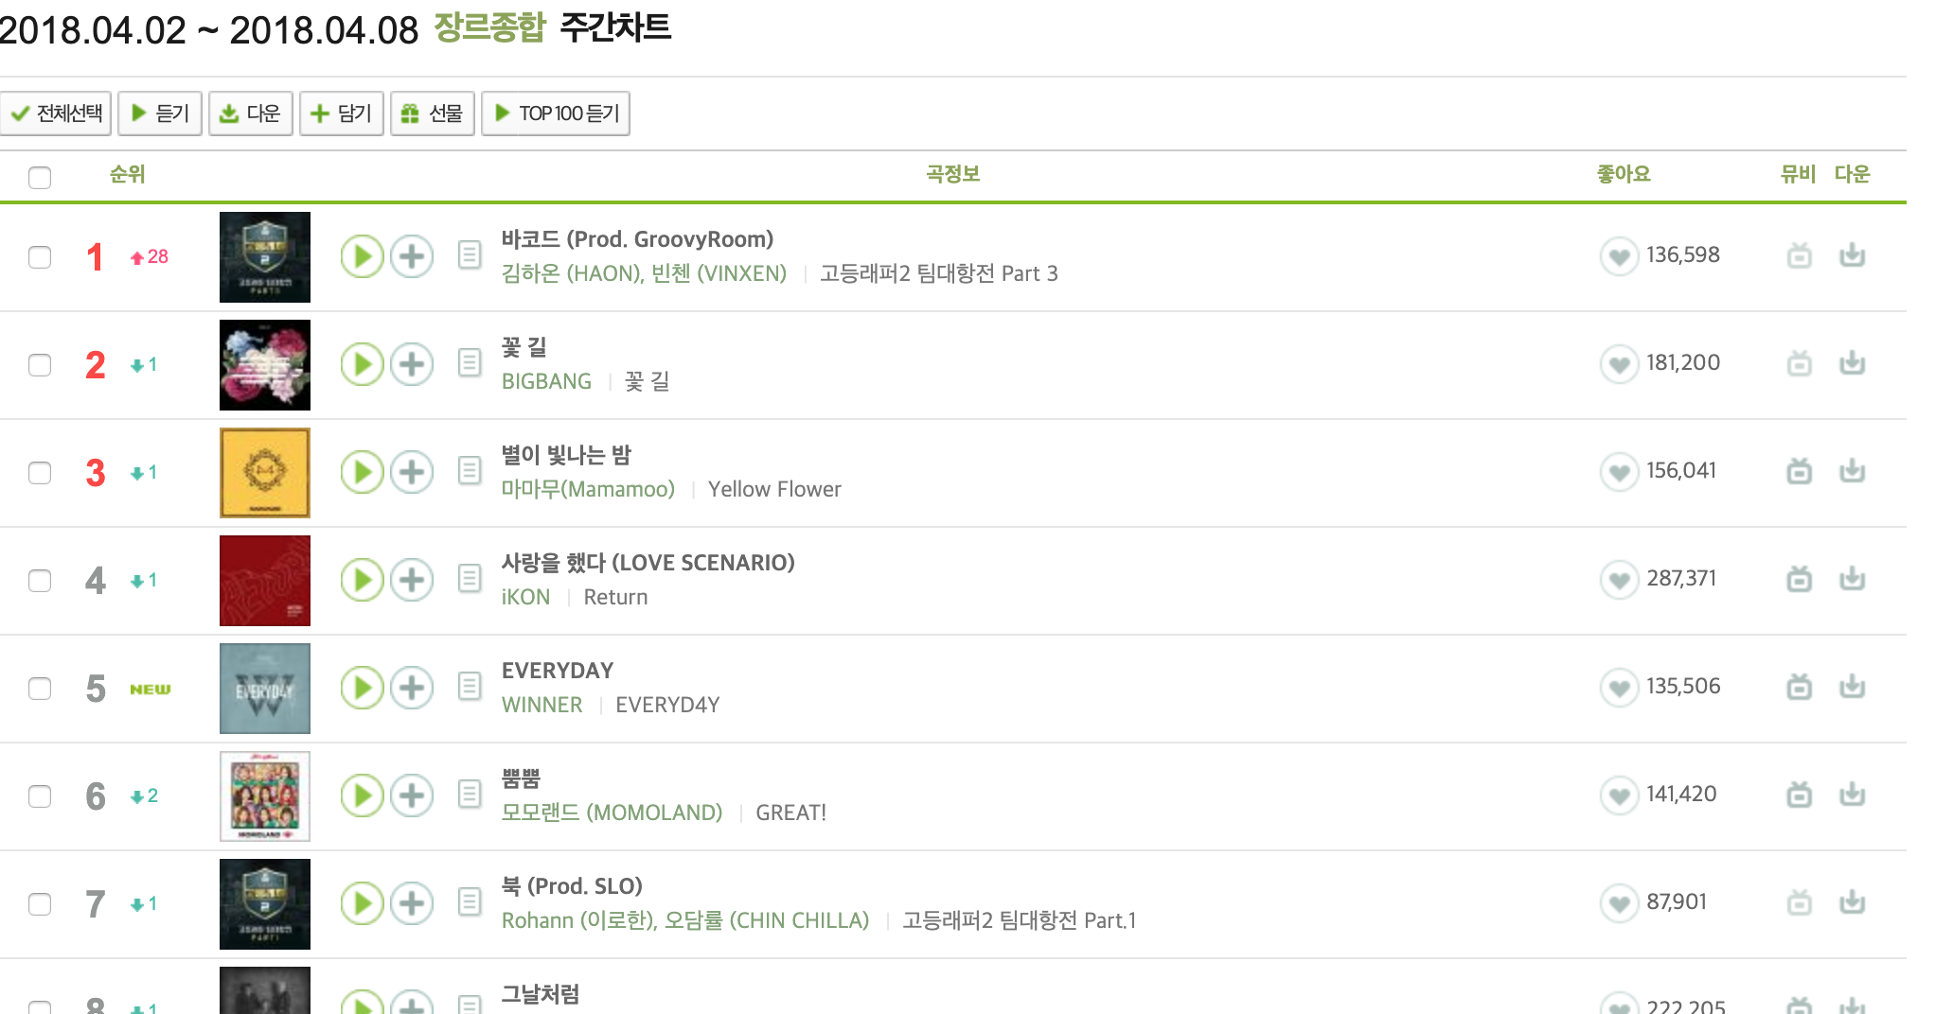
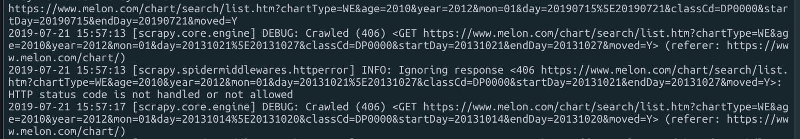
Scraping issues
Billboard
Melon
In this case, Use selenium instead of scrapy
Notes:
For scraping, the billboard used scrapy and melon used selenium. In Melon's case, the http 406 error occurs when scraping a ranking page. It's a case of blocking crawling on the site. However, since it is not blocked by the firewall, it can be resolved by simply accessing the parent page, having the session, and moving to the ranking page and crawling with selenium.

Slide 5
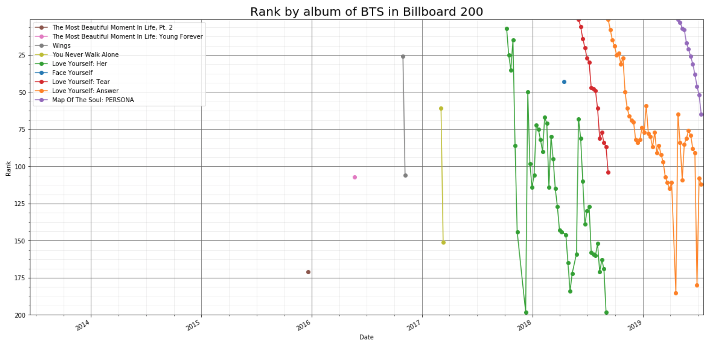
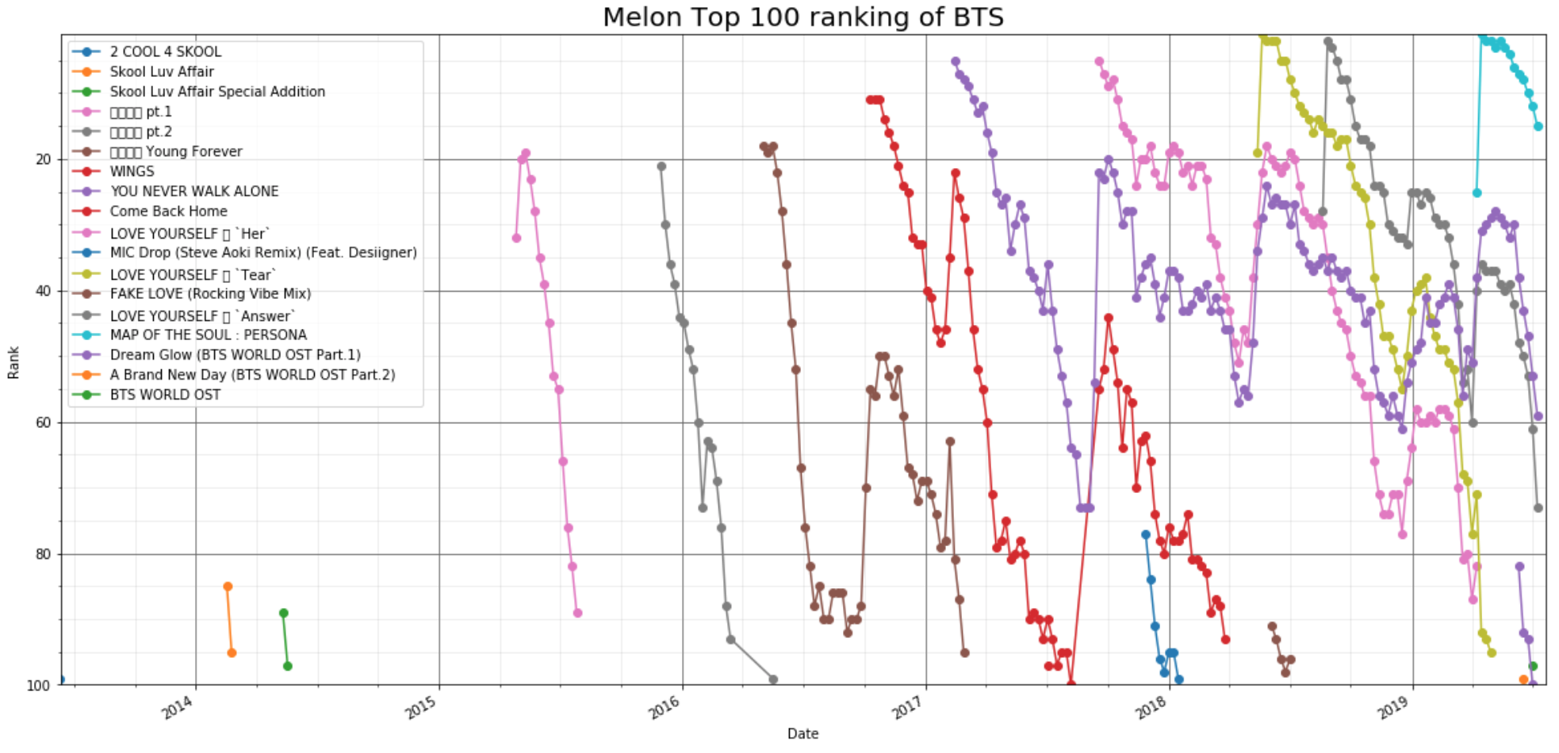
Hypothesis 1
BTS first became popular in the U.S. and was popular in Korea due to its influence.
Therefore, the ranking indicator of the billboard will precede the ranking indicator of the melon.
Verification method
Let's Compare the rank data by date.
Notes:
I hypothesized that BTS' popularity in Korea was affected in the United States and compared its ranking by date to verify it.

Slide 6
Ranking chart(Billboard)
The debut is in 2013, but it is starting to make it to the top of the rankings in late 2016.
Notes:
This is billboard200 ranking of BTS by date.
The debut is in 2013, but it is starting to make it to the top of the rankings in late 2016.

Slide 7
Ranking chart(Melon)
Despite its steady popularity, it is relatively recent that it was ranked on the top
Notes:
This is melon ranking of BTS by date.
Melon has a song ranking instead of album ranking. So, I assumed that the highest song on the album was ranked on the album list.

Slide 8
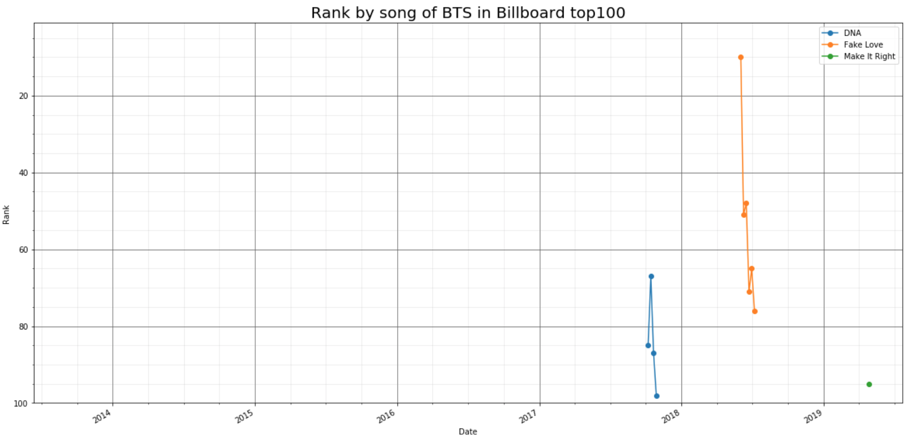
Ranking of top100
There is no big connection between sing and it`s album rankings.
Notes:
This is the ranking of songs in the same period.
There is no big connection between sing and album rankings.

Slide 9
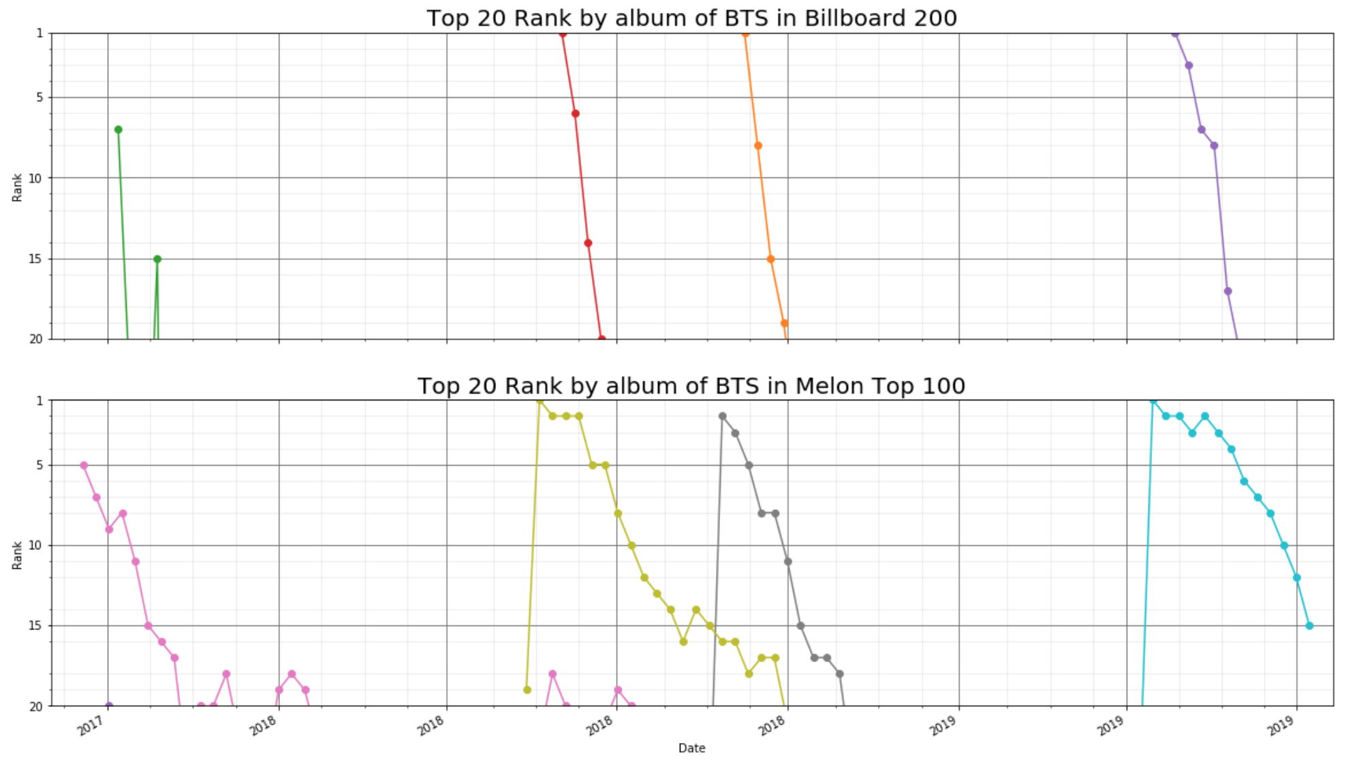
Notes:
These are graph of the latest of the two charts zoomed in and compared. For the previous album, you can see that it is ranked higher in the U.S. than in Korea.
At the time of release, the album was ranked low and then rapidly rose.
but this doesn’t exactly mean BTS is more popular in U.S. than in Korea.
Although I didn't verify the hypothesis with this data, I found that the two charts looked similar.

Slide 10
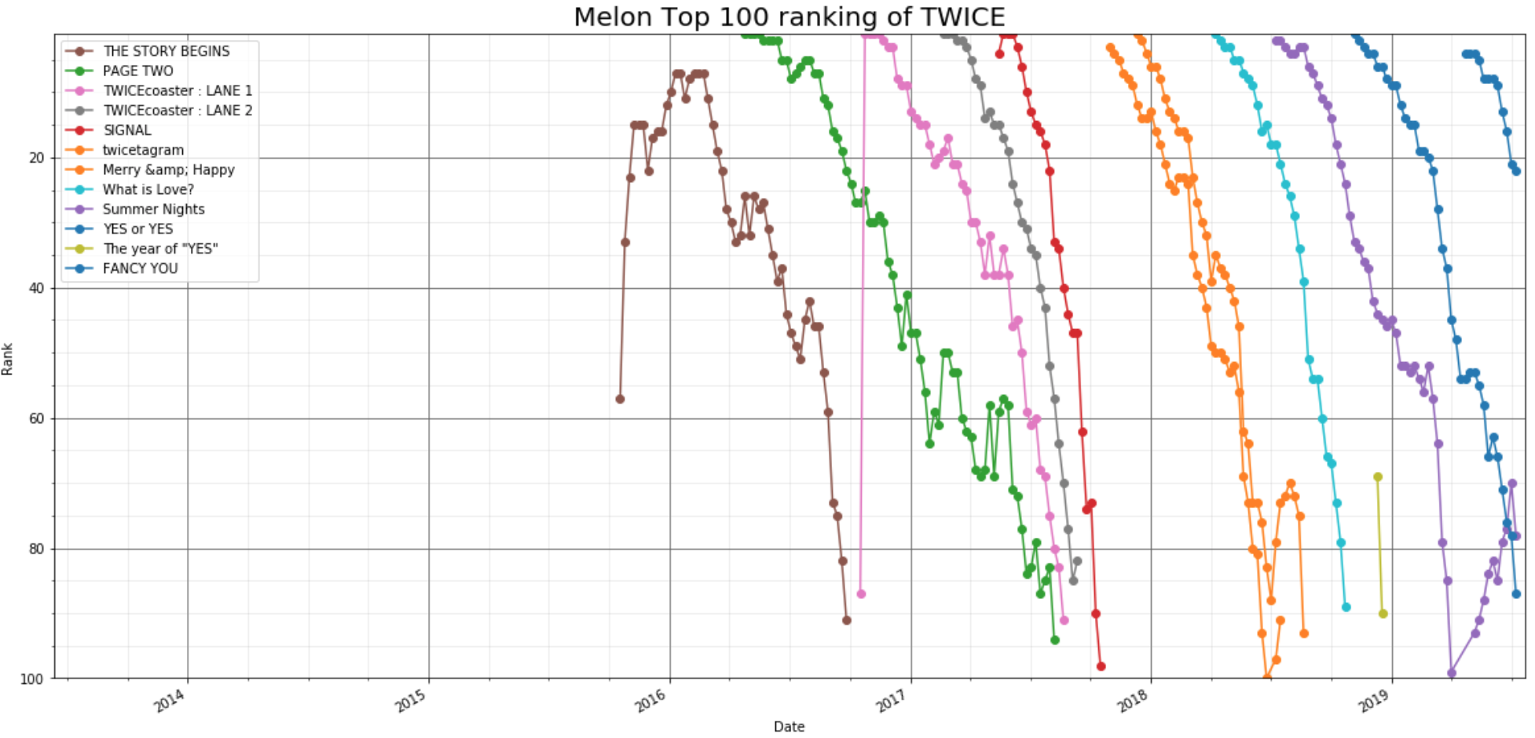
Notes:
For example, Look at the chart of a girl group called Twice, you'll see that most of the albums are No. 1 as soon as they're released.

Slide 11
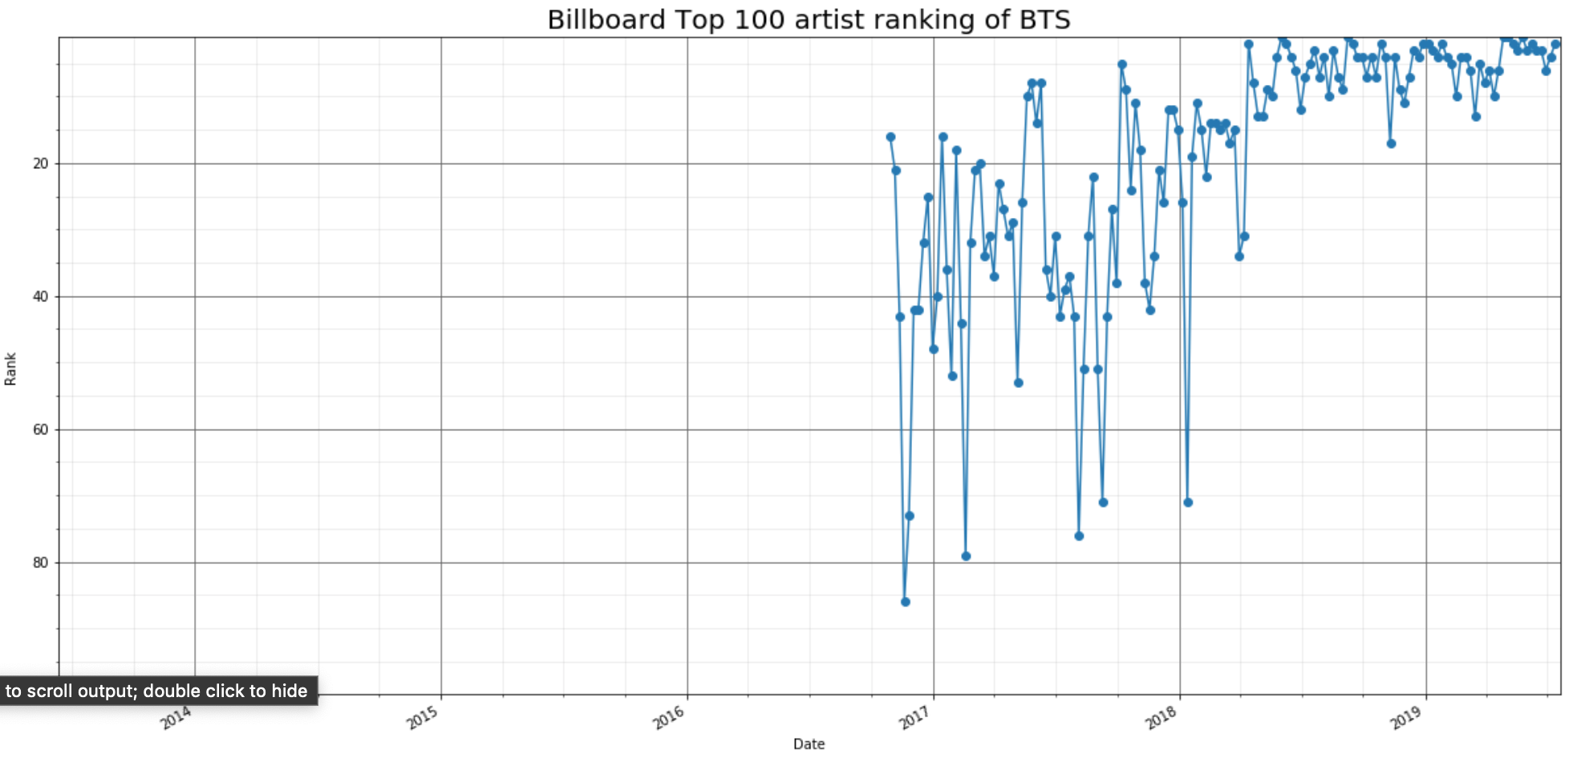
Hypothesis 2
BTS' artist's ranking may have affected the album ranking.
Therefore, the recognition may have gone up.
Verification method
Let's compare the rank of the artist and the album.
Notes:
The second hypothesis is that there is a connection between album rankings and artist rankings, which eventually affects recognition.

Slide 12
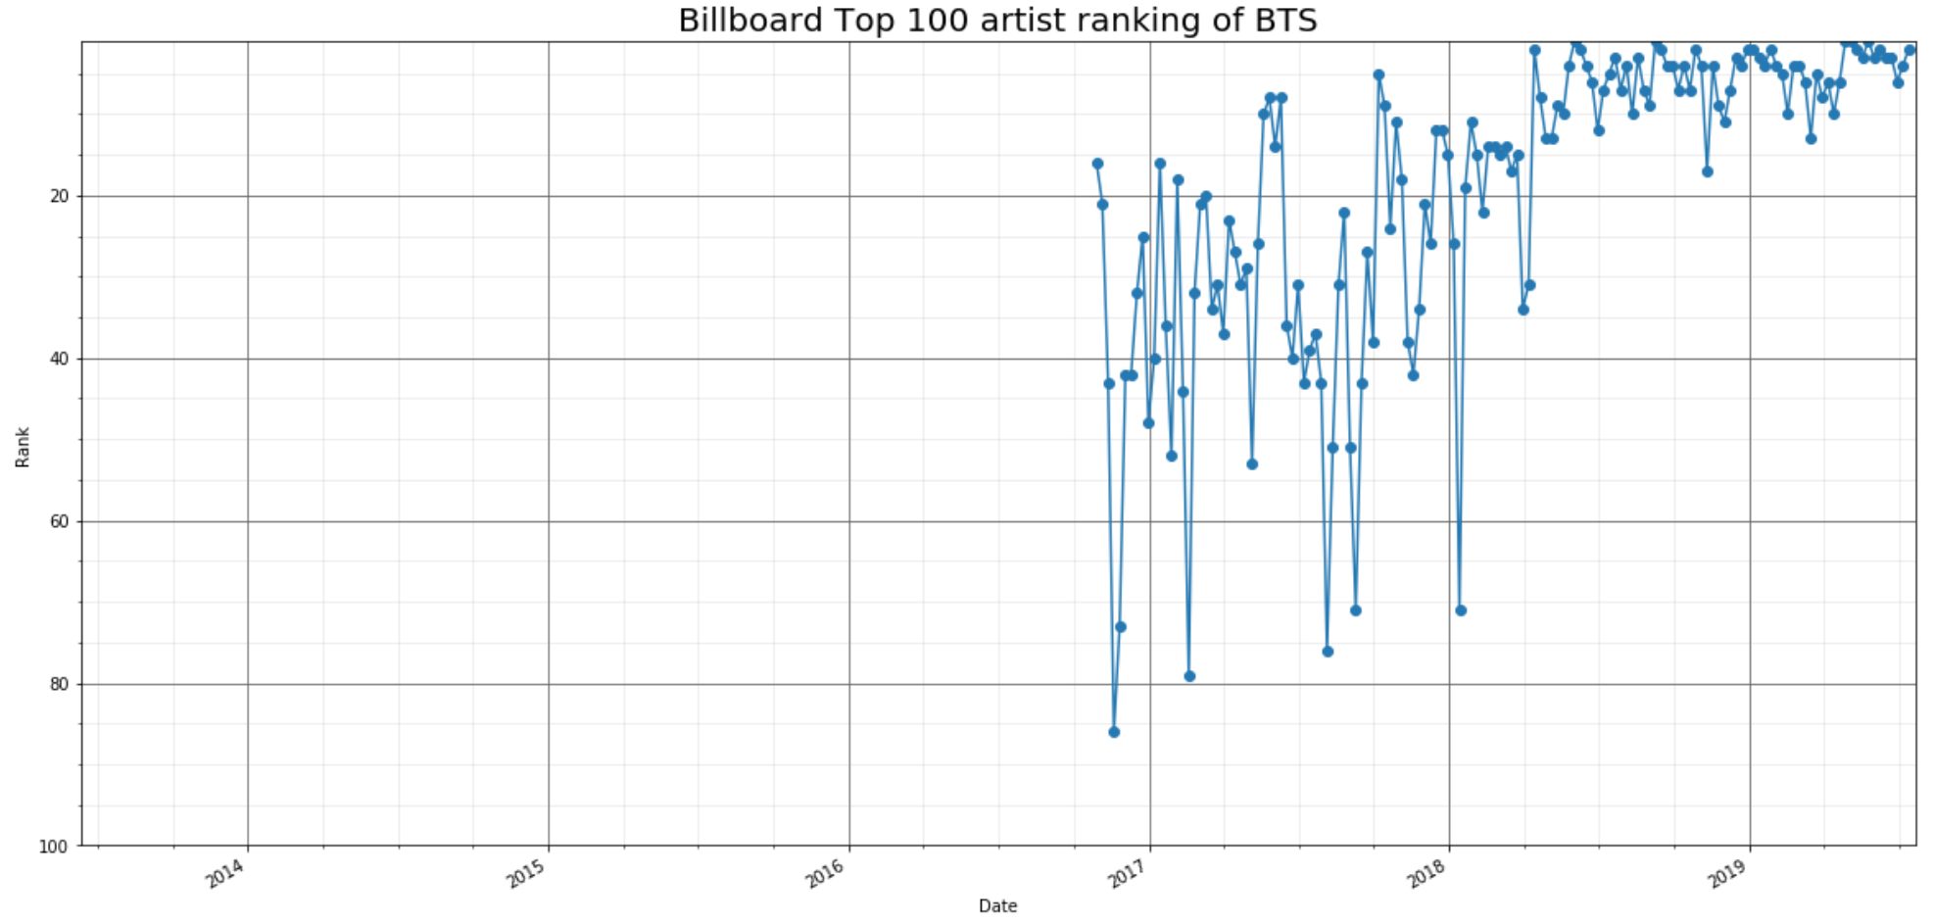
Since the first quarter of 2018, the rank of artists has risen dramatically.
Notes:
Since the first quarter of 2018, the rank of artists has risen dramatically.

Slide 13
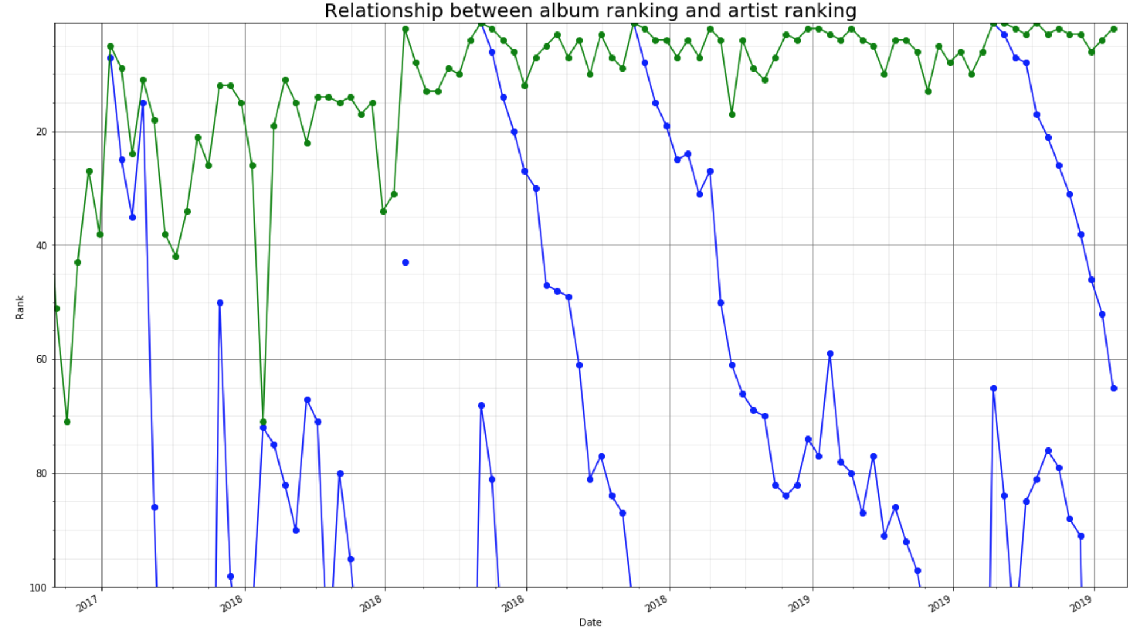
Album
Whenever the album topped the charts, the artist also reached the top.
Notes:
Whenever the album topped the charts, the artist also reached the top.
And all albums released since the first quarter of 2018 when the artist's popularity rose to the top of the charts.

Slide 14
Notes:
Here's an interesting fact.
When a new album is released, the ranking of the previous album will be raised as well.

Slide 15
Notes:
We can see the same thing on the Melon chart.
This means that the higher the artist's ranking, the more attention the old album gets when it comes to releasing a new album.

Slide 16
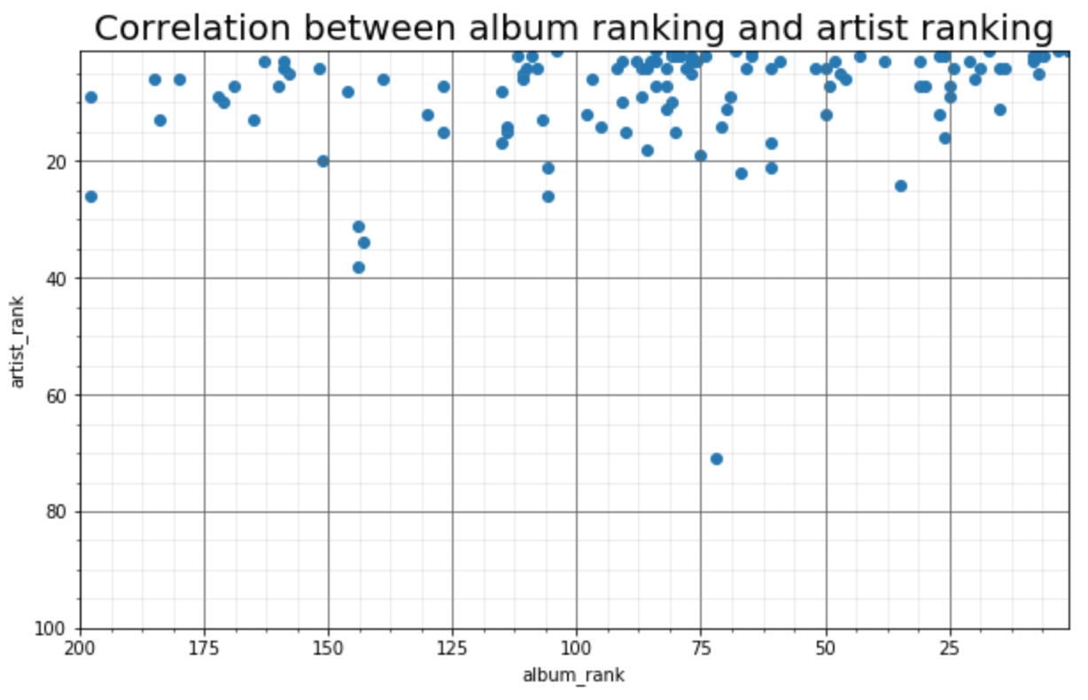
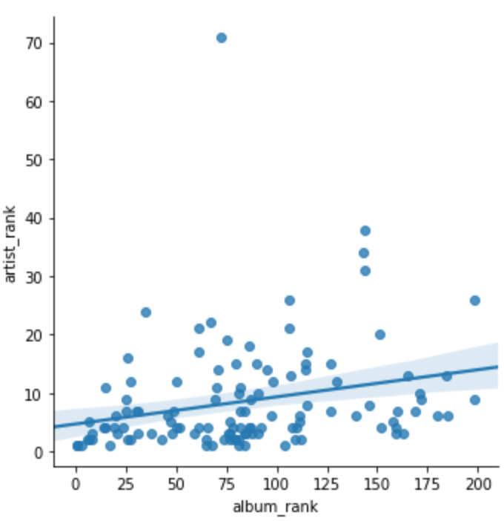
This graph shows the relationship between album ranking and artist ranking.
The higher the ranking of the album, the higher the artist's ranking of the artist.
Notes:
This graph shows the relationship between album ranking and artist ranking. The higher the ranking of the album, the higher the artist's ranking of the artist.

Slide 17
Conclusion
01
02
03
04
05
Title text preset
Title text preset
Title text preset
Title text preset
Title text preset
This part of the content as a text layout placeholder display (Recommended theme font)
This part of the content as a text layout placeholder display (Recommended theme font)
This part of the content as a text layout placeholder display (Recommended theme font)
This part of the content as a text layout placeholder display (Recommended theme font)
This part of the content as a text layout placeholder display (Recommended theme font)
Notes:
Fewer data and many logical breakthroughs have prevented proper hypothesis testing.
It seems hard to find the answer to the question of where BTS is more popular with ranking charts alone. In the future, we will collect unstructured data such as SNS and articles and conduct more objective analysis.

Slide 18

Thank you for listening.
Notes:
Thank you for listening.

